Slide 1
Enhance Dataset labeling Model

Slide 2
Research Journey
Enhance Dataset labeling Model
To improve the accuracy and reliability of vulnerability detection, our enhanced labelling model integrates AI- driven automation with advanced validation techniques.

Slide 3
Research Journey
Enhance Dataset labeling Model
Key Enhancements in the Model:
AI-Powered Pre-Labeling
Automated Validation & Correction
Metadata Enrichment
Synthetic Data Generation

Slide 4









Research Journey
Early-stage error detection
Rigorous accuracy validation
Established standards comparison
Iterative development
focus
Test Dataset
Benchmark Dataset

Slide 5


Research Journey
Resources of test Dataset
cwe.mitre
OWASP

Slide 6


Research Journey
Sources of Benchmark dataset
(Manually collected )

Slide 7
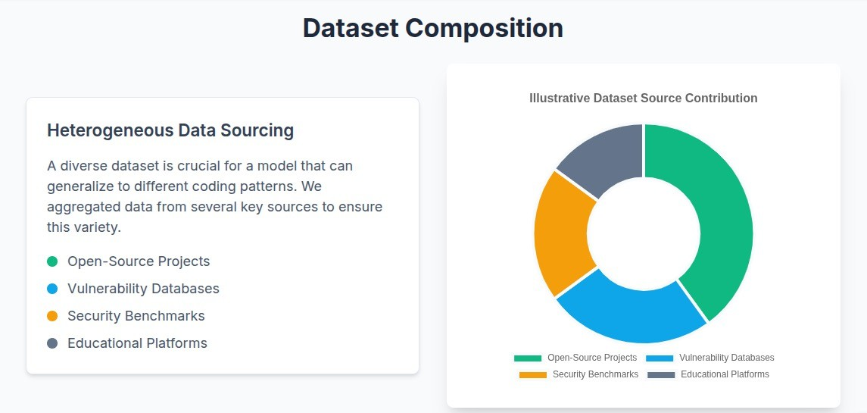
Research Journey

Slide 8
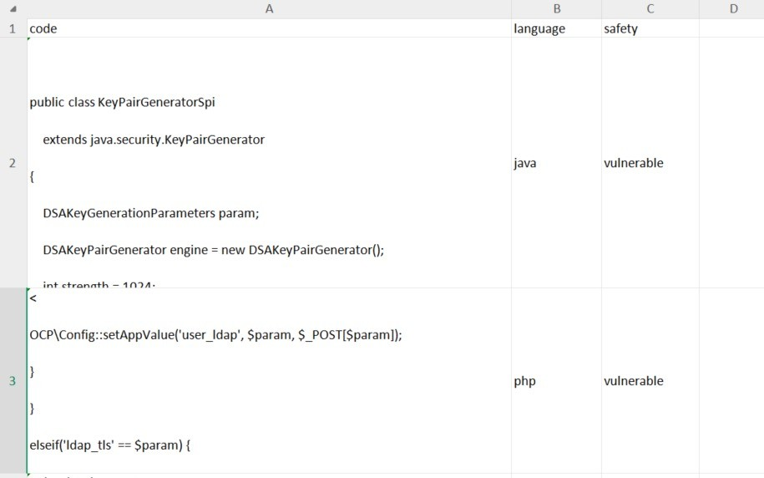

Research Journey
Large datset to be enhanced:
CVEFixes from Kaggle

Slide 9
Research Journey
Dataset labeling Processes
Pre-processing
Input: Raw dataset (CSV file with code snippets).
Task: Clean the dataset by removing duplicates, empty rows, and unclear data.
Output: Cleaned dataset ready for labeling.

Slide 10
Research Journey
Dataset labeling Processes
Pre-labelLing
Input: Cleaned dataset.
Task: : Label unlabelled code snippets as "Vulnerable" or "Non-Vulnerable." Identify the type of vulnerability
Output: Dataset with initial labels.

Slide 11
Research Journey
Dataset labeling Processes
Validation
Input: Labelled dataset.
Task: : Review and correct labels.
Output: Final validated dataset.

Slide 12
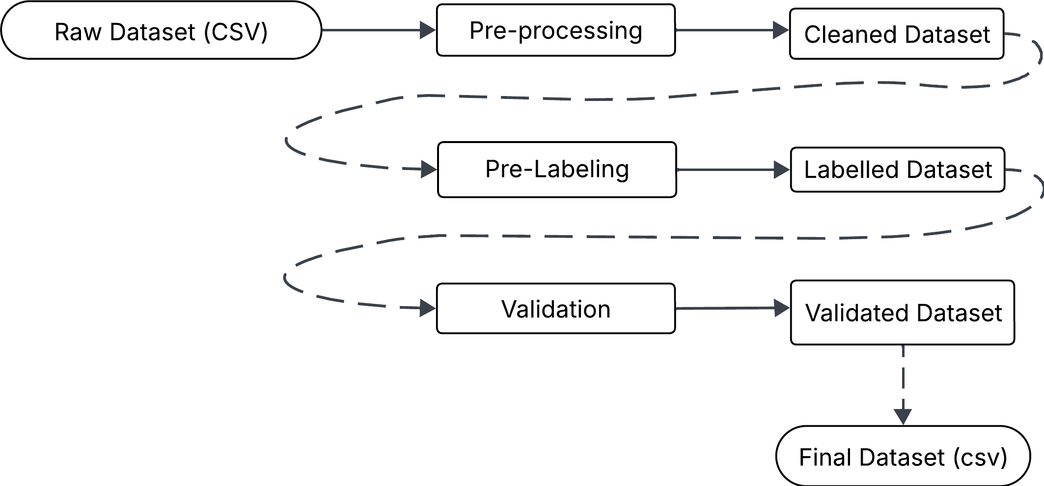
Research Journey

Slide 13
Research Journey
New feature
Ok the previous workflow is amazing , but now I want to enhance it and make new level of high dataset to deliver more high quality Dataset
To further improve dataset quality, we introduce an advanced HITL (Human-in-the-Loop) enhancement step. This ensures that ambiguous, complex, or edge-case data is reviewed by human experts before finalizing the dataset.

Slide 14
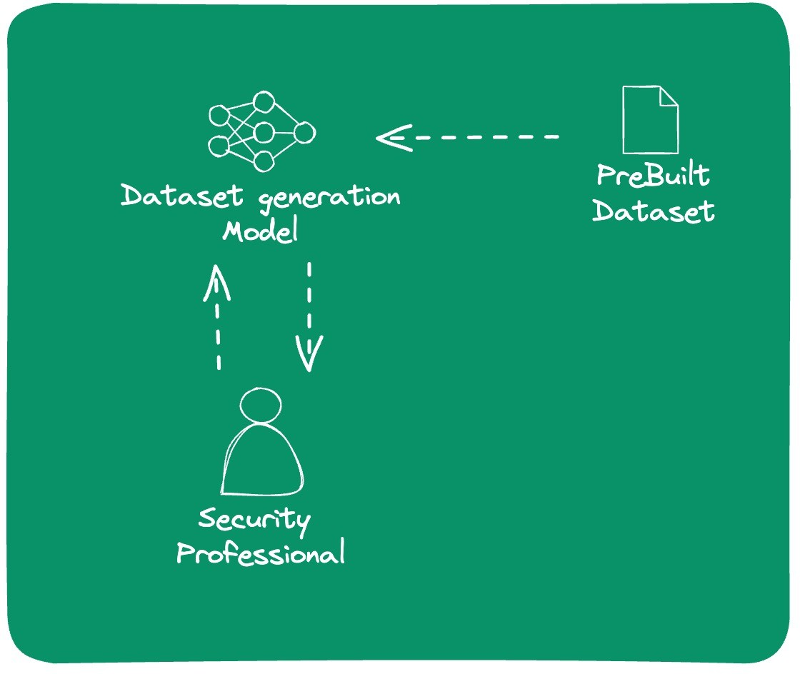
Human-in-the-Loop

Slide 15


Research Journey
ITL ( uman-in-the-Loop)
HITL is a hybrid approach where AI automates most of the tasks but incorporates human expertise when needed. It is particularly useful in vulnerability labelling because:
Increases Accuracy Handles Ambiguity
Ensures High-Quality Data

Slide 16
Research Journey
Dataset labeling Processes
Human-in-the-Loop (HITL)
Input: Ambiguous cases flagged by the Validation Agent.
Task: Send ambiguous cases to human annotators for review. Retrieve human-validated labels and integrate them into the dataset.
Output: Dataset with human-validated labels.

Slide 17
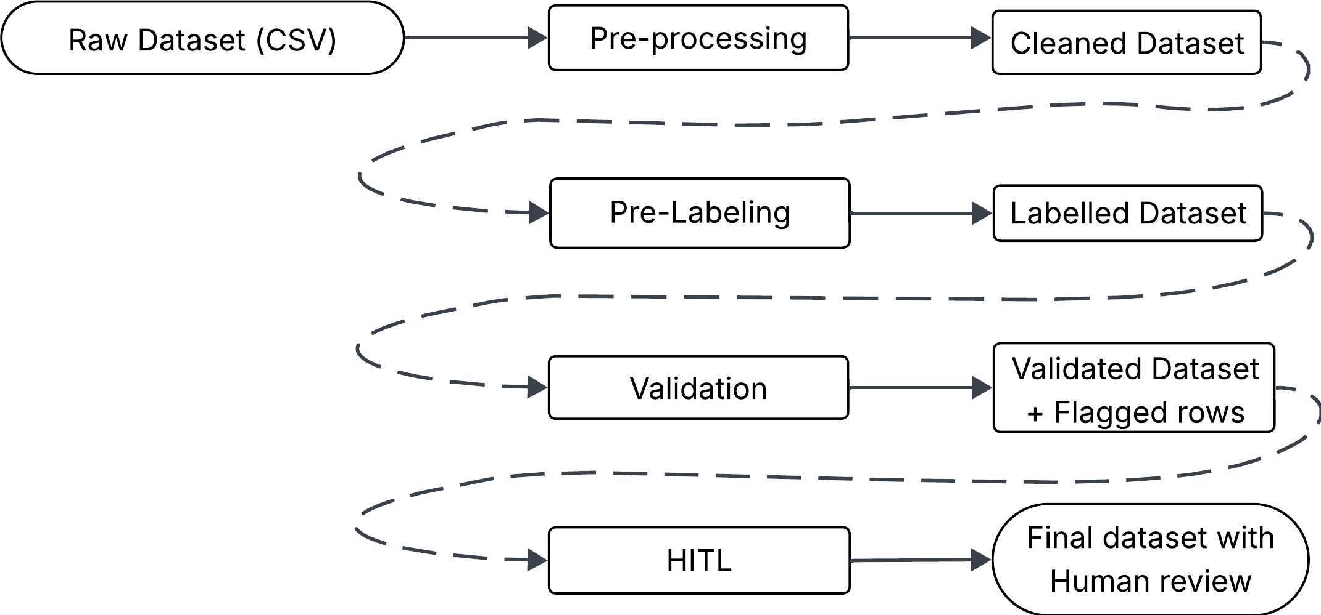

Slide 18
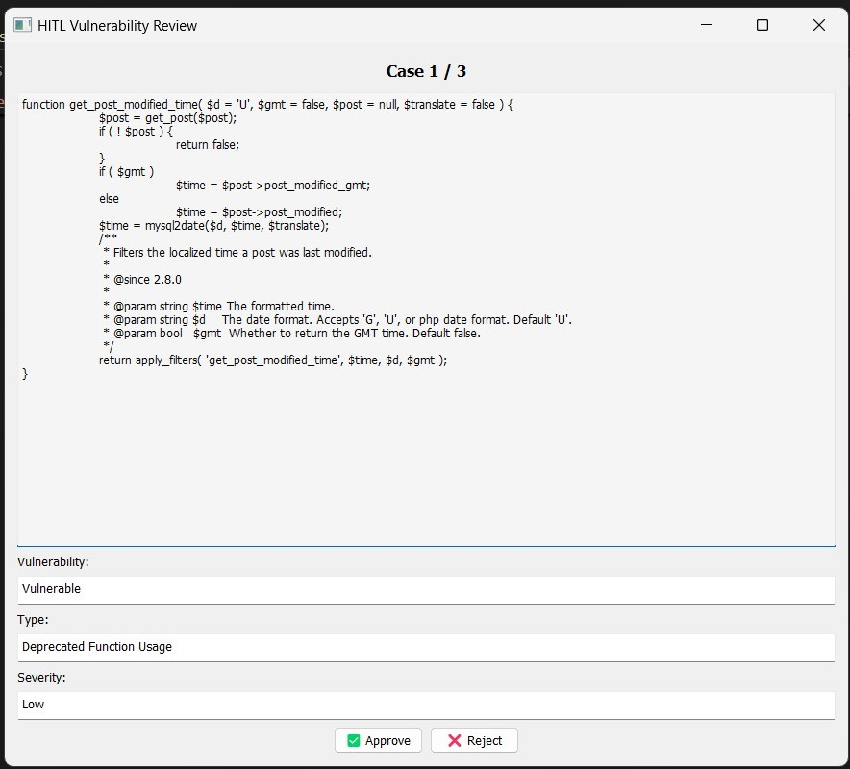
ITL GUI

Slide 19
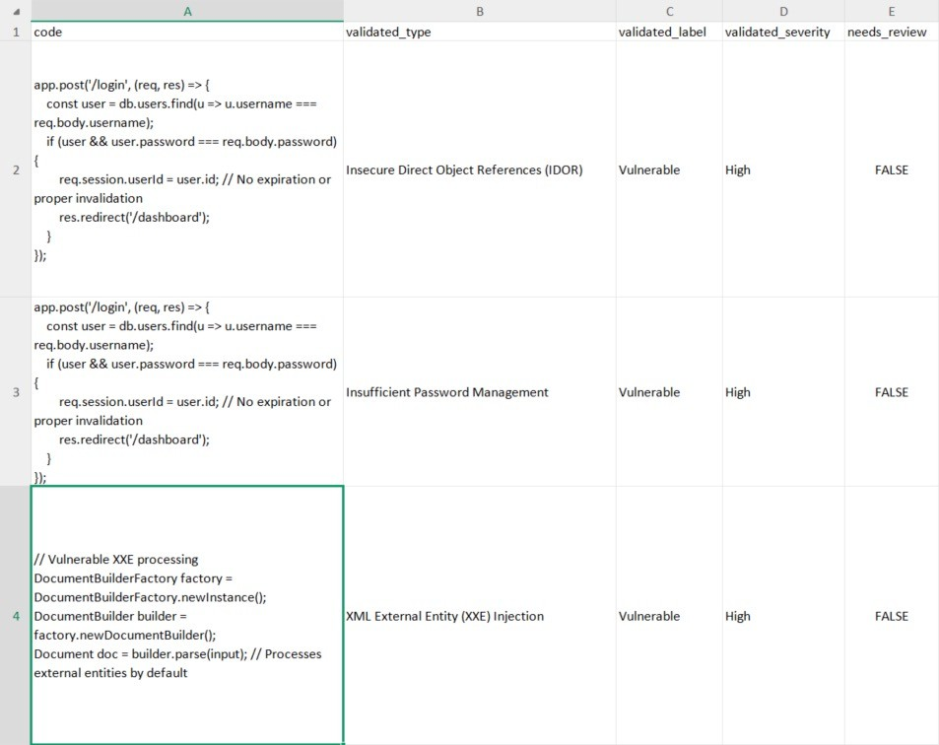
Final Output

Slide 20
Benchmark Dataset
Data Modification Random changes applied to 70% of data
Model Input
Modified data fed into the
model
Model Run
Model processes the input
data
Output Comparison Model output compared with benchmark labels
Accuracy Calculation Process
Model Accuracy

Slide 21
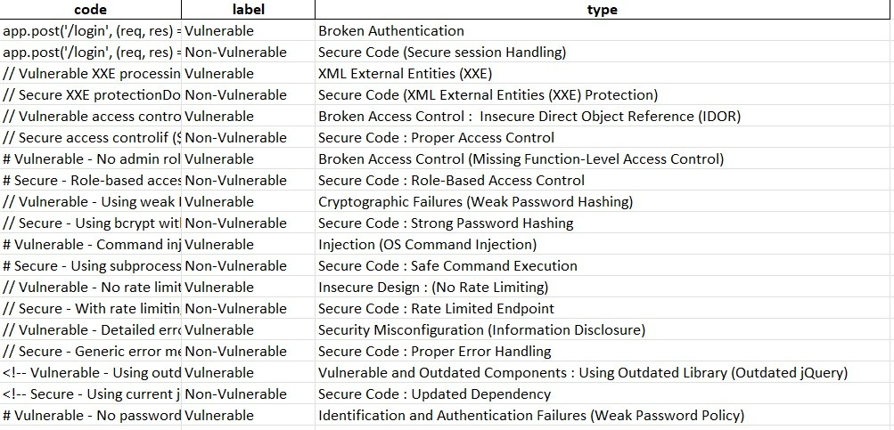
Benchmark Dataset

Slide 22
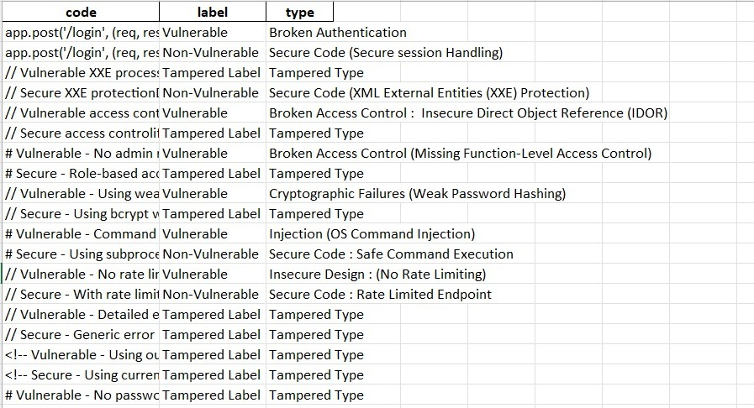
Modified Benchmark Dataset

Slide 23
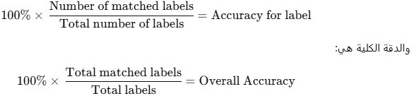
Accuracy Function

Slide 24
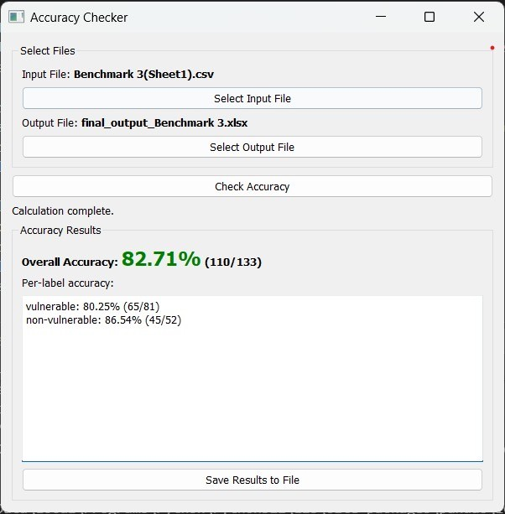
Final Result

Slide 25
Thanks !

